Slide 1
Smart Robotic Cart: A Prototype
Kallistah Allen Darrah Beebe Jason Braker
Advisors: Dr. Suruz Miah Dr. Prasad Shastry
Department of Electrical and Computer Engineering, Bradley University, Peoria IL

Slide 2


Slide 3


Problem Statement
Design a robotic cart that follows the user
Does not use line-of-sight sensors to locate the user

Slide 4
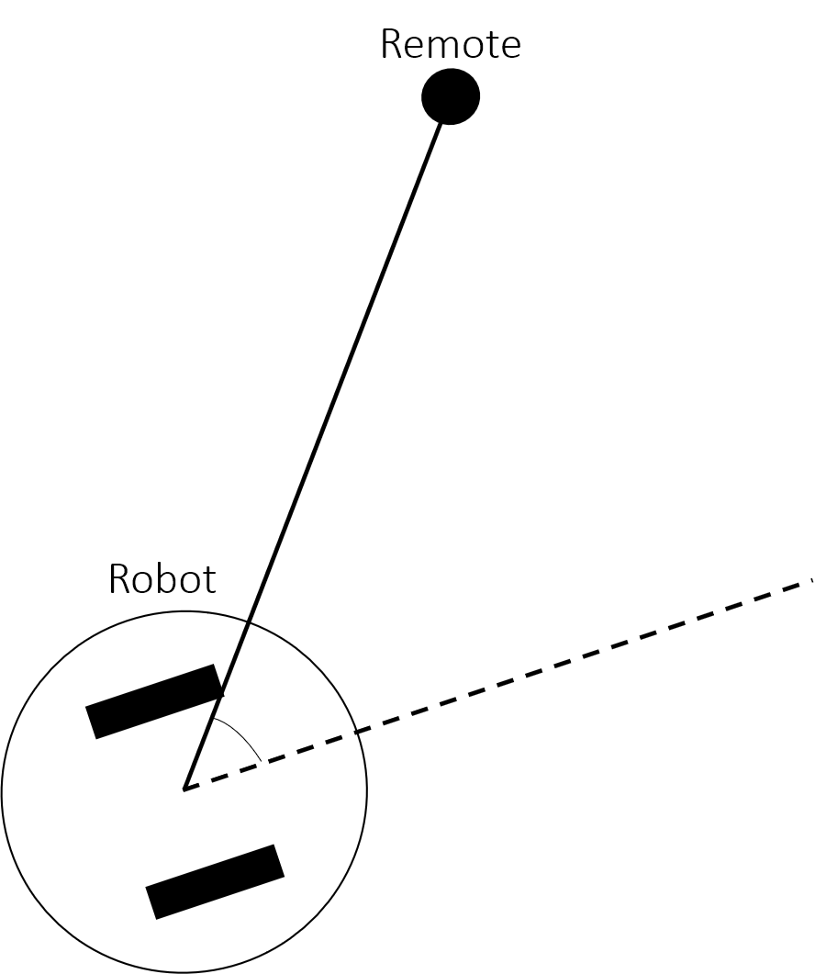
Line-of-Sight Sensing
Line-of-Sight sensors must have an open path between the sensor and the object being sensed (no obstacles between)
Existing smart carts use line-of-sight sensors
If line-of-sight is not required, the robotic cart could still maintain communication with the remote on the user and be able to locate the user when an obstacle comes between them
Obstacle

Slide 5
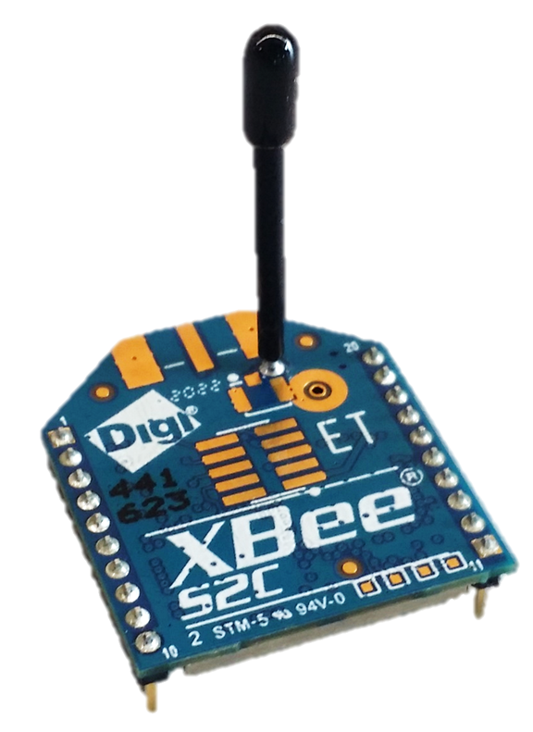
Proposed Solution
Utilize wireless analog radio frequency (RF) signals
Benefits:
Cost-effective
Signals propagate through objects, so communication does not require line-of-sight
Downside:
RF signals are noisy due to reverberations

Slide 6
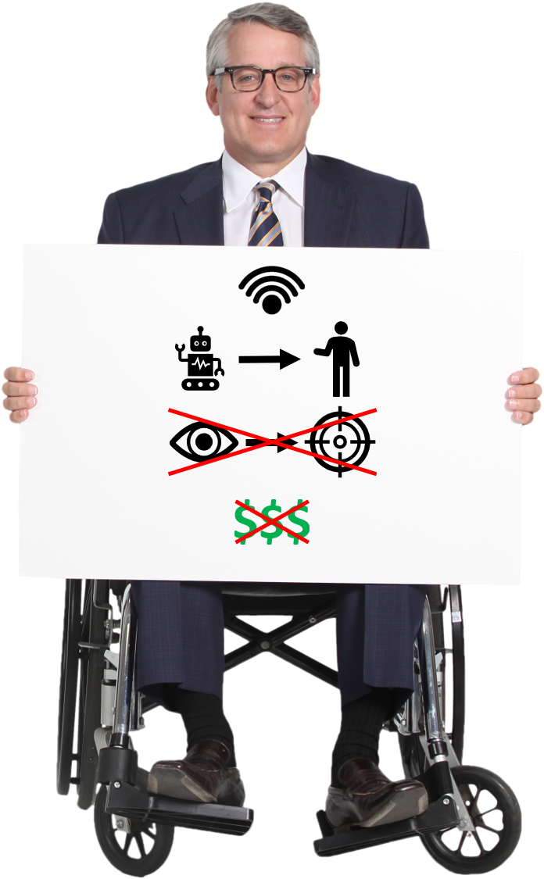
Project Goals
The robotic cart system should:
Utilize wireless signal strength to locate the user
Move to follow the user
Not use line-of-sight sensors to follow the user
Have a cost-effective design

Slide 7
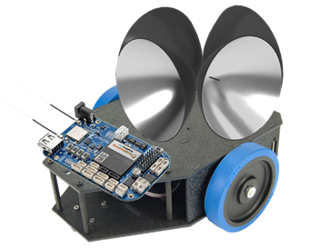
Robotic Cart Specifications
Cart should be able to follow the remote target
Cart should remain a distance of 1 [m] to 1.5 [m] from the remote target
Cart should be able to attain a speed of at least 1 [m/s]
Cart should not require line-of-sight to follow remote
Notes:
Transition to Darrah

Slide 8
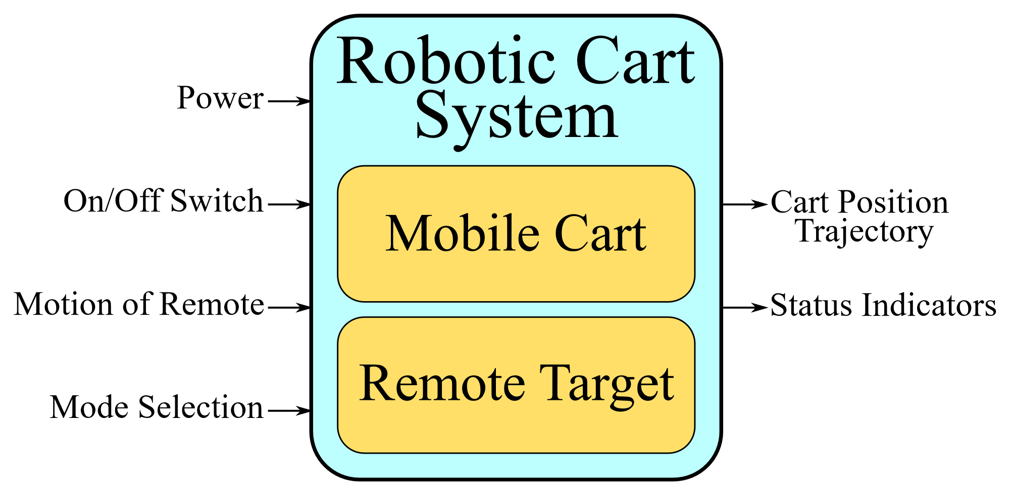
Robotic Cart System Block Diagram
Four inputs
Two outputs
Inputs
Outputs

Slide 9
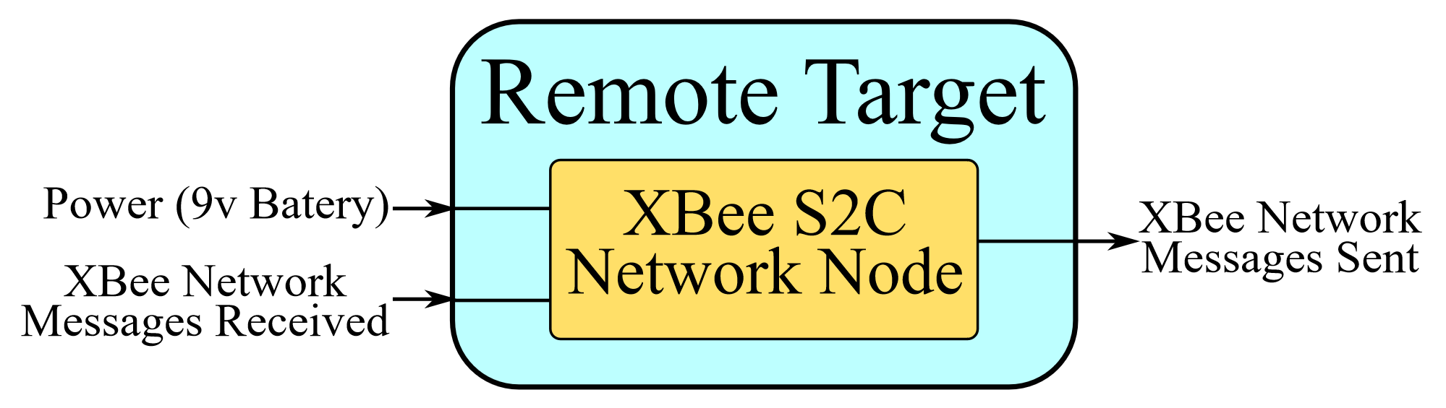
Remote Target Subsystem Block Diagram
Two inputs
One output
Output
Inputs

Slide 10
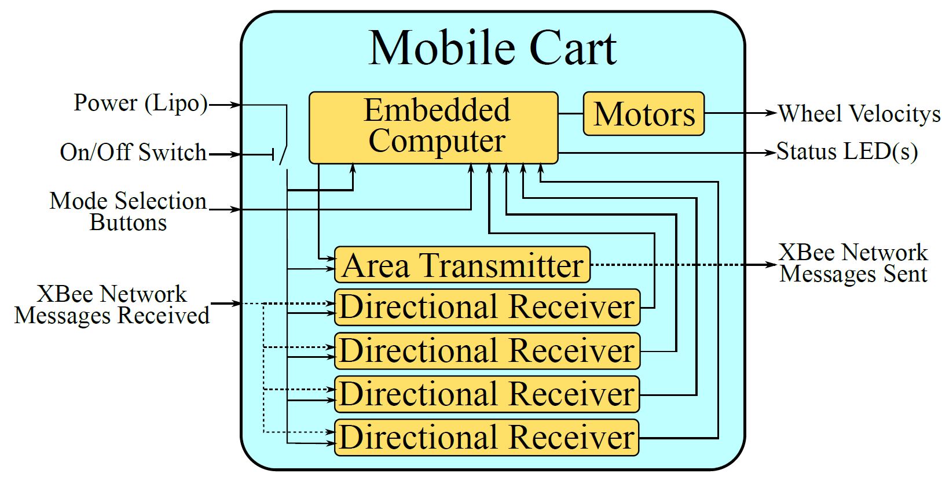
Mobile Cart Subsystem Block Diagram
Four inputs
Three outputs
Inputs
Outputs

Slide 11
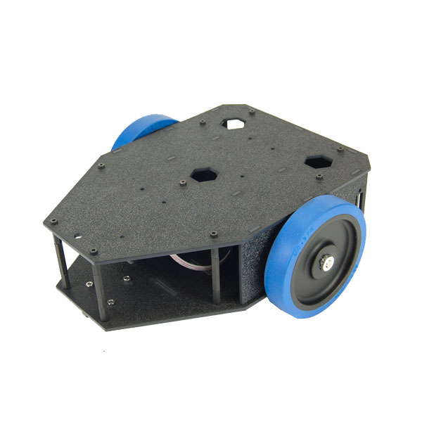
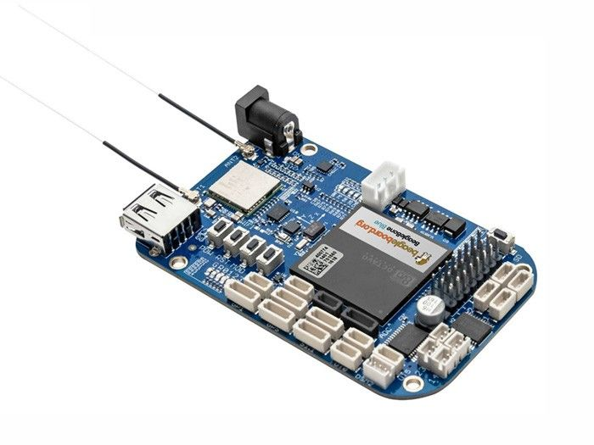
Main System Components
Budget Bot Chassis - Physical framework of robotic cart
BeagleBone Blue - Embedded computer to control robotic cart
XBee S2C Module - Wireless communication module
Budget Bot Chassis
BeagleBone Blue
XBee S2C Module

Slide 12
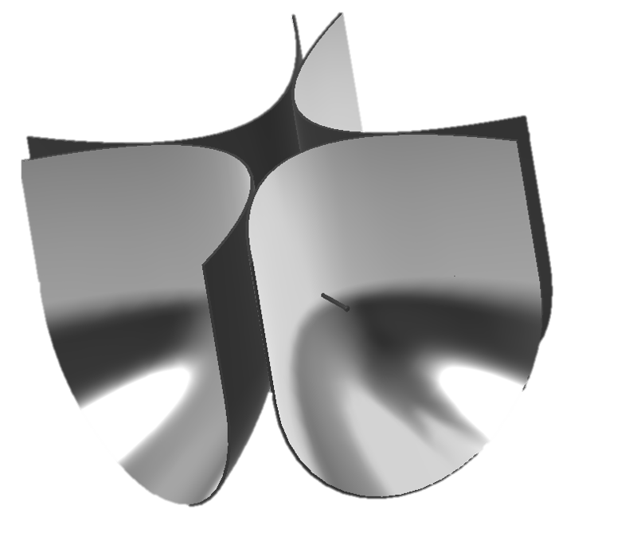
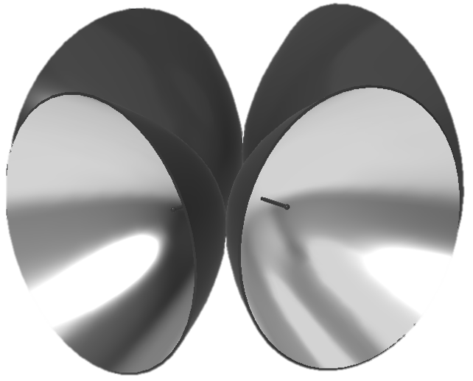
Reflector Arrays
Two designs
Paraboloidal - focuses signals coming directly into reflector
Parabolic/Paraboloidal - better reception of signals from above
Model 1: Paraboloidal Reflector
Model 2: Combined Parabolic/Paraboloidal Reflector

Slide 13
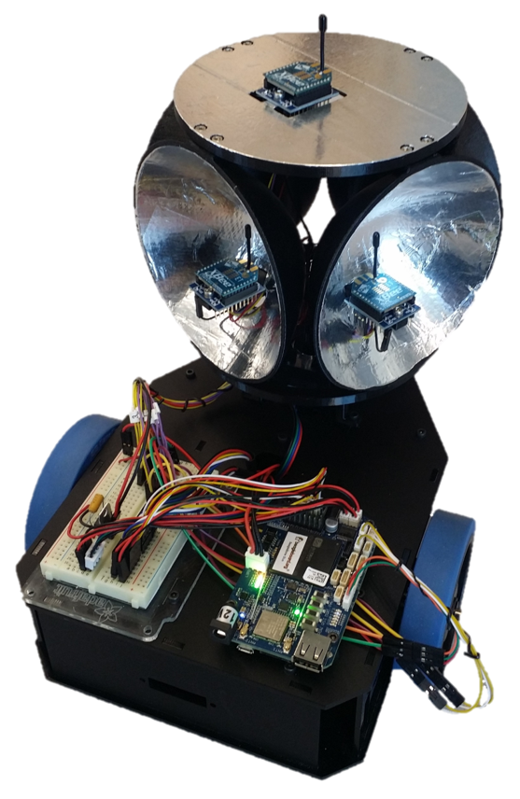
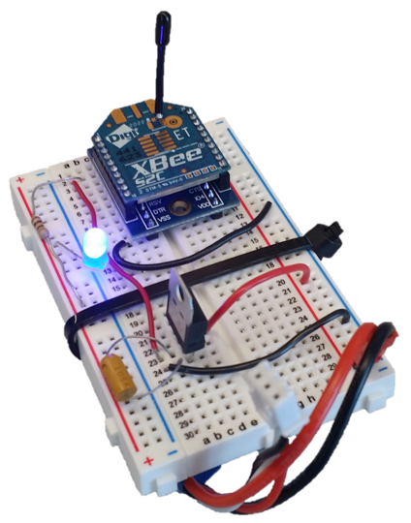

System Prototype
We created a prototype robotic cart using the paraboloidal reflector design. This prototype was used for testing.
Robot
Remote
Notes:
Transition to Jason

Slide 14
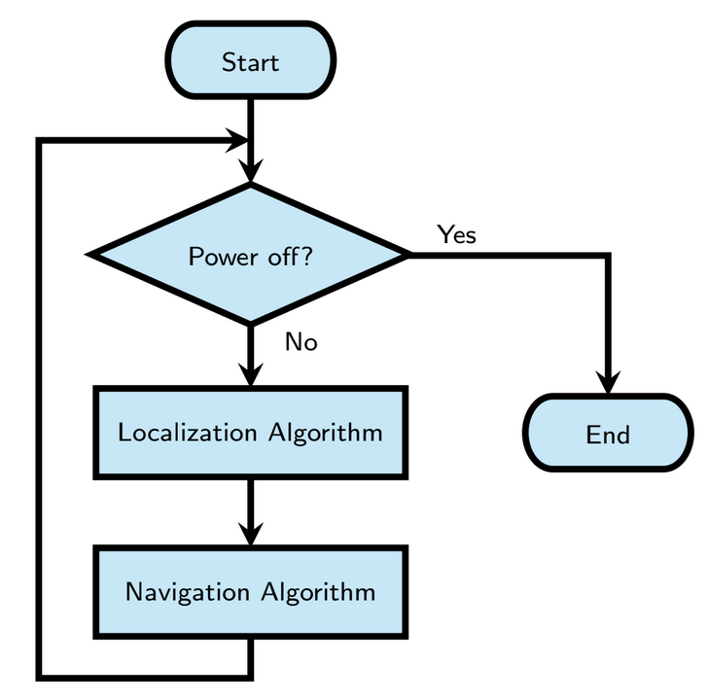
Operation of Mobile Cart System
Repeatedly execute Localization and Navigation Algorithms until powered down

Slide 15
Localization Algorithm
Coordinator sends request for signal strength measurement to remote
Remote responds with its measured signal strength
Receivers measure signal strength of message from remote
Rotate reflector array 9 degrees
Repeat steps 1-4 until 10 measurements have been taken
Calculate distance to remote using strength of signal received by remote
Calculate angle to remote as the direction of the maximum signal strength measured by the receivers

Slide 16
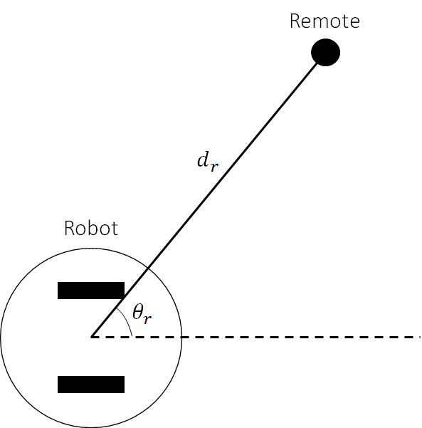
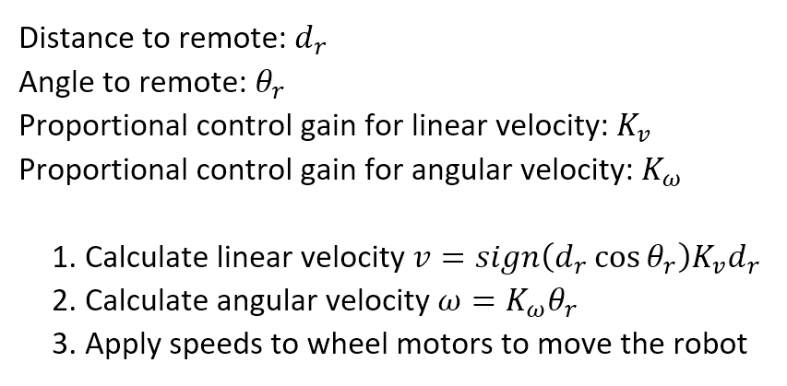
Navigation Algorithm

Slide 17
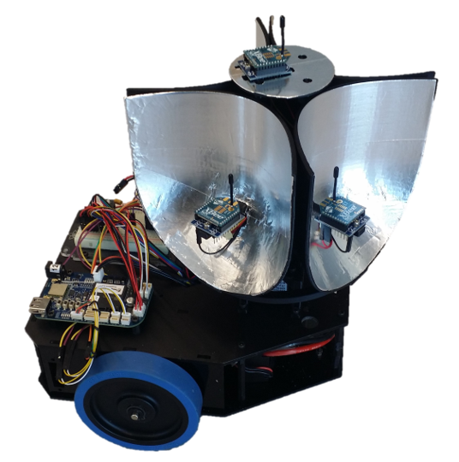
Robot Model 2 (In Progress)
Uses the combined parabolic/paraboloidal reflector shape
Intended to allow better reception of signals from above
This model is not yet tested
Notes:
Second robot with different reflector shape
Remote is likely to be held higher than the robot, so this shape may work better since it will get better reception of signals from above

Slide 18
Current Challenges
Accuracy of angle estimation is low and causes some errors in the robots trajectory to the remote
Possible solution: Implement the Extended Kalman Filter (EKF) algorithm to filter out noise
Distance estimation is not consistent and will drastically change if the user stands between the remote and the robot

Slide 19
Conclusion
Designed and implemented a cost-effective robotic cart that is able to locate and follow the user
We are continuing to refine our design to better solve the problem

